Slide 1
CACTUS HOTEL
Text Talk Words
Old Wire Elementary

Slide 2
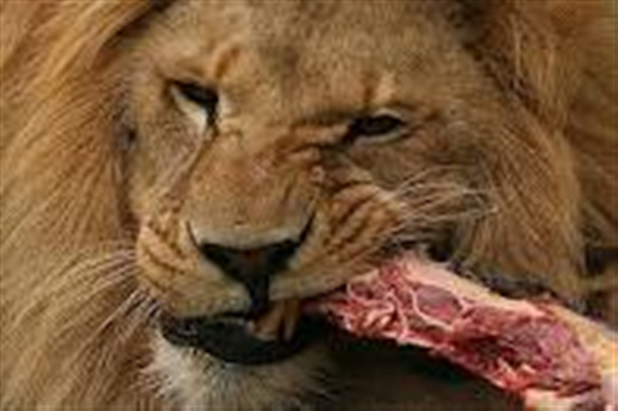
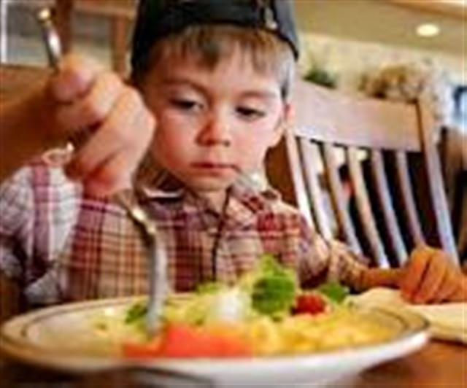
The word gnaws means to bite or chew with the teeth.
A jackrabbit cools off beside the cactus and gnaws on the green pulp.
Which picture goes with gnaws? Explain why you think the picture goes with gnaws.
Lion Boy

Slide 3
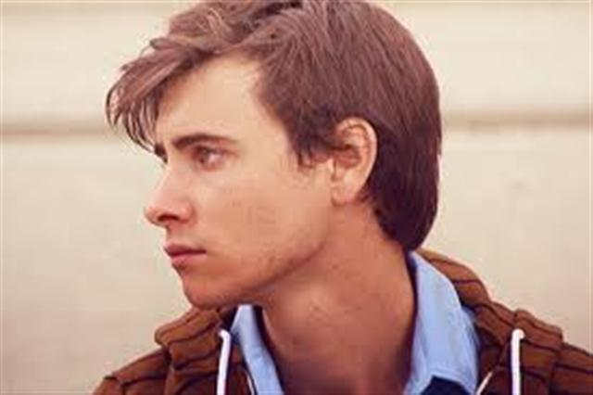
The word beckon means to call or signal someone to come.
Every spring flowers will open on top of the cactus for one night only. The flowers beckon like a welcoming signal across the desert.
Which picture goes with the word beckon? Explain why the picture shows the word beckon.
Man #1 Man #2

Slide 4
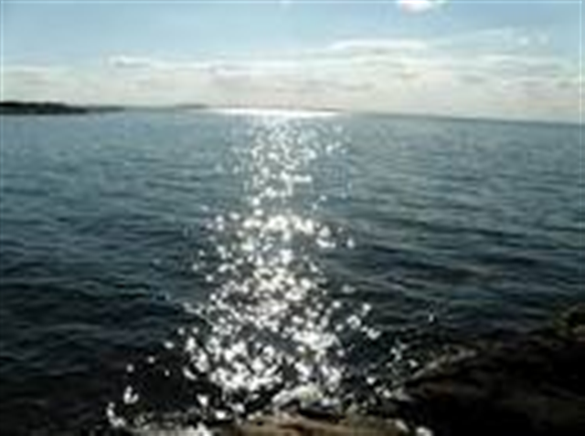
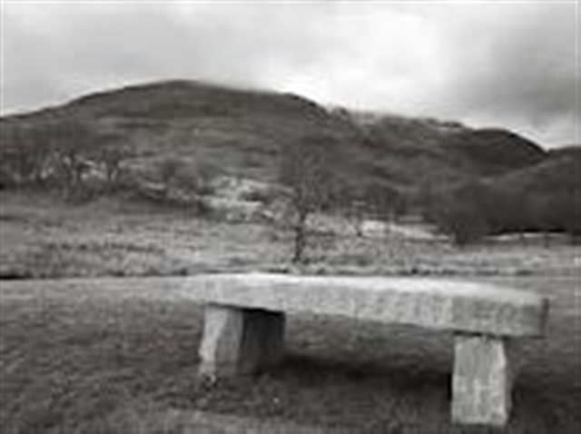
The word glisten means to shine.
On a hot, dry day in the desert, a bright-red fruit falls from a tall saguaro cactus. It splits apart on the sandy floor. Two thousand black seeds glisten in the sunlight.
Which picture goes with glisten? Explain why the picture goes with the word glisten.
Water Stone Bench

